Slide 1
Movie Ratings Predictor
By :
Nitish Wadhwa
Mayank Kumar

Slide 2


Problem Statement: The Profound Question
The primary objective of the project is to develop a robust framework for predicting the audience and critics ratings of the upcoming movies based on several attributes
The successful prediction of ratings plays a vital role in movie industry because it involves huge investment

Slide 3
Project Process
1
Business Understanding : To understand the Profound Question
2
Data Understanding : To Understand and Accumulate the data
3
Data Preparation : To convert the data into analysis friendly form
4
Modelling : To choose and implement the algorithm suited for the problem
5
Evaluating: To analyze the output and make prediction.

Slide 4
Data Understanding :Collection of Data
The Data is collected from “Rotten Tomatoes” a review-aggregation website for film and television
Data for Director and Actors likes has been collected from Facebook pages.
Data has attributes:Movie Name, Audience Rating,Critics Rating,Actor_names, Actor_links, Synopsis,Release Date,Genre ,Studio, Directed By etc.

Slide 5
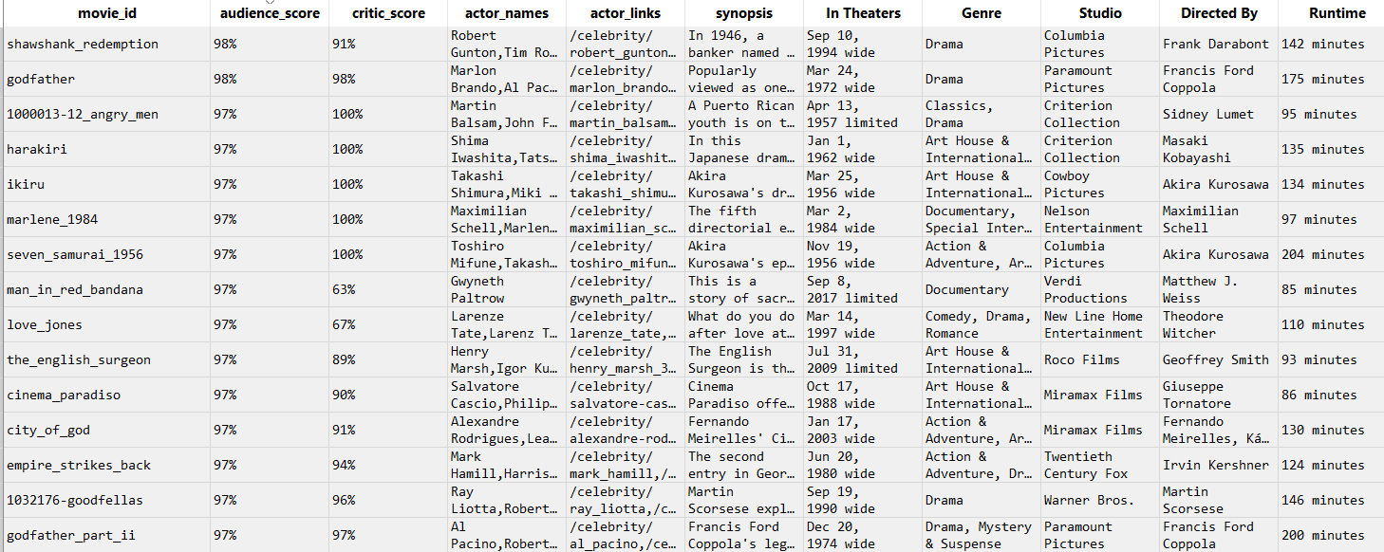
Dataset Preview

Slide 6

Data Preparation : Cleaning of Data
We have performed the data cleaning on the data set to make sure there is no missing values and outliers.
We have converted special characters like $ and % to numbers.
We modified the data in a layout and format that is capable to be read by csv reader tool

Slide 7
Methodology : SVM
To obtain the desired prediction about ratings of the movie we will be using the Support Vector Machine model.
SVM is a supervised machine learning algorithm which can be used for classification or regression problems.
It uses a technique called the kernel trick to transform your data and then based on these transformations it finds an optimal boundary between the possible outputs.
It does some extremely complex data transformations, then figures out how to separate your data based on the labels or outputs you've defined.

Slide 8
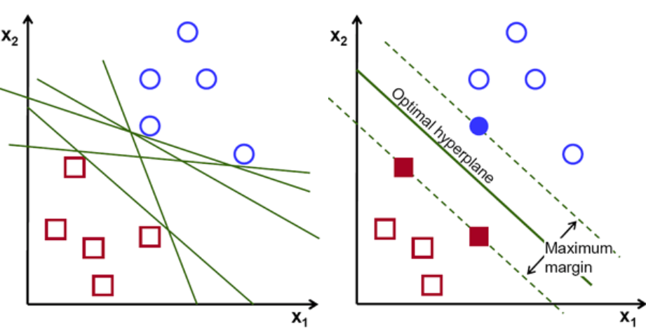
Methodology : Why SVM ?
Capable of doing both classification and regression
It can capture much more complex relationships between your datapoints without having to perform difficult transformations on your own
Objective of the SVM algorithm is to find the hyperplane that has the maximum margin in an N-dimensional space(N — the number of features) that distinctly classifies the data point.

Slide 9
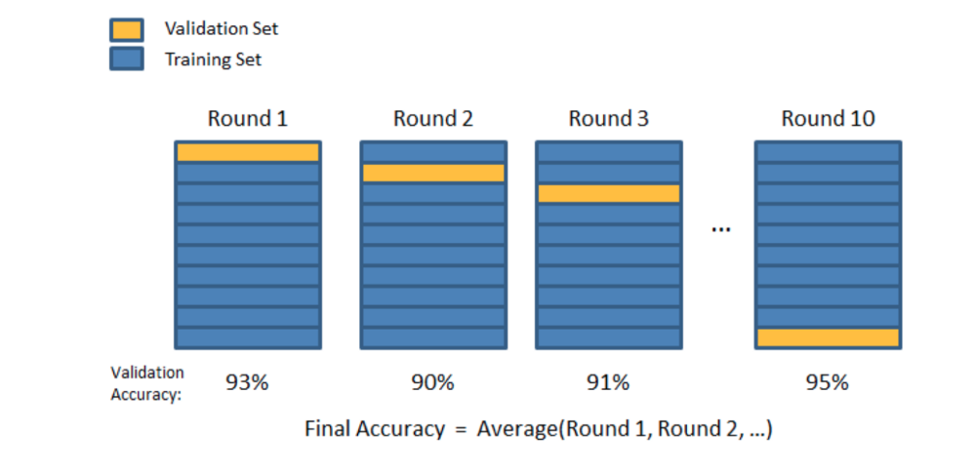
Methodology
Training data: 70% of data set
Test data: 30% of data set
We have used K-cross folds validation with k=10

Slide 10
Methodology
We have used SVM Linear (SVC) for the Linear Classification
SVM Linear performs classification by finding the hyper plane that maximizes the distance margin between the two classes
We have used SVM Regression(SVR) for the Regression.
SVR is used for working with continuous values instead of Classification

Slide 11
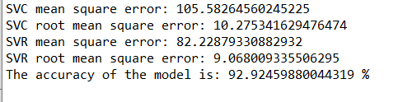
Model Evaluation :Outputs
Mean squared error: It is a single value that provides information about the goodness of fit of the regression line. The smaller the MSE value, the better the fit, as smaller values imply smaller magnitudes of error
Root Mean squared error: It is square root of the Mean square error value

Slide 12
Software Package
Python 3.7
Selenium Python
Microsoft Excel

Slide 13
Software Package
We have used following dependencies in our project:
1.) CSV : To read the data from the stock prices
2.) Numpy : To perform calculations
3.) Scikit-Learn : To build a predictive model
4.) Pandas : To perform data manipulation and analysis

Slide 14
Conclusion
Out of all the SVM model discussed here, SVR model fits the data more accurately and hence gives the best prediction.
This tool provides a robust framework for predicting the gap between audience score and critics score on various variables such as actor,director,studio etc.
Support Vector machines provide very simple method for linear classification but performance in case of non linearly separable data, largely depends on the choice of kernel.

Slide 15
Thank You !!!

